Slide 1
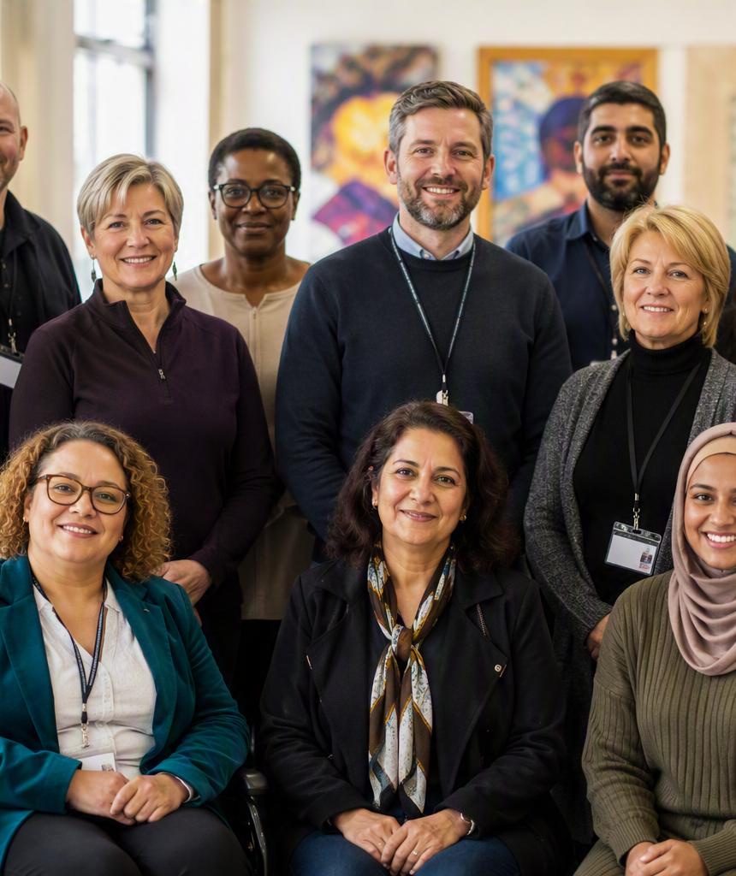
Wolverhampton Safeguarding Together Partnership (WST)
Annual Report 2025-2026
Easy read version
Notes:
[Sources]
- Content adapted directly from the attached source document: EASY READ 2026 Wolverhampton-safeguarding-together-wst-annual-report-2025-26 V1.docx.
- Visual on this slide was generated with Microsoft Copilot.
[/Sources]

Slide 2

ABOUT WST
What is the WST Partnership?
The WST Partnership is the name for all the agencies who work to keep children and adults safe

Slide 3
ALISON HINDS, CHAIR OF THE WST EXECUTIVE GROUP SAYS:
We are pleased to present Wolverhampton Safeguarding Together Partnership’s Annual Report covering from 1st April 2025 to 31st March 2026.
This has been produced on behalf of the partnership by Amy Weir, Independent Scrutineer. It provides independent oversight and assurance of our safeguarding practices.
This report is focused on the partnership’s work in relation to safeguarding children, young people and adults with care and support needs.
We want to start by taking the opportunity to thank all our frontline practitioners and managers, who work tirelessly to improve outcomes for children, young people and adults with care and support needs daily. It is their commitment, dedication, and care that enables the partnership to translate its strategic priorities into operational practice to keep the residents of Wolverhampton safe.

Slide 4

OUR WORK
What did WST do in 2025-2026?
WST reviewed its work to assess how effectively it was keeping children and adults safe.
WST learned from people who had used services by finding out as much as possible about their experiences.
WST also offered training for people working with children and adults. Training involves gaining new skills or learning new information.
Lessons also came from situations where things had gone wrong or someone had experienced harm.

Slide 5
WHAT WE LEARNED
What did WST find out about its work?
WST is doing a lot of good work to keep children and adults safe.
Some people said how much help they got:
“A big thanks because at one point in my life, they really did save me.”
(Young Person Power 2 Trauma Informed Team).
“I’m very confident with the family plan. I refused the help before, but now we have a family plan in place I know what support my family are willing to offer.”
(Parent)

Slide 6
AREAS TO IMPROVE
WST needs to do some things better, such as:
Making sure each person’s differences are thought about and that Equalities, Diversity and Inclusion (EDI) and taken into account.
Do more to involve the people who use the services and to make sure their voice is heard.
Make sure that staff who work with children and adults get the training they need to help them do their job.

Slide 7

LEARNING FROM REVIEWS
What did WST learn from the reviews of children and adults?
WST looked at several cases where children and adults experienced harm or died as a result of abuse or neglect.
A review helps identify lessons that can guide future practice.
The findings highlighted a need for further training and risk management and support for professionals to raise concerns about the people they work with.
Further work is needed to ensure that everyone working with children or adults has access to the information they need.
Notes:
[Sources]
- Content adapted directly from the attached source document: EASY READ 2026 Wolverhampton-safeguarding-together-wst-annual-report-2025-26 V1.docx.
- Visual on this slide was generated with Microsoft Copilot.
[/Sources]

Slide 8
2026-2027
What happens next?
Improve the support to people who have been harmed for a long time.
Make sure that children receive the help they need as they become adults.
Finish the work from last year.
The full report can be accessed here: WST Annual Report 2025-2026
IF YOU WANT TO KNOW MORE:
Contact: WST@Wolverhampton.gov.uk

